Slide 1
Grothony Global Solutions
Your Partner in Digital Marketing and Development Services

Slide 2

Introduction
Explore Grothony Global Solutions' expert services designed to elevate your brand's online presence through effective digital marketing strategies.

Slide 3
01
Digital Marketing

Slide 4

SEO Strategies
Gain visibility on search engines by implementing targeted keyword strategies, optimizing website content, and improving site speed. Understand the importance of backlinks and local SEO to reach your desired audience and enhance online ranking.

Slide 5
Content Marketing
Create valuable content that informs, entertains, or solves problems for your audience. Utilize blogs, videos, podcasts, and infographics to engage your audience. Develop a content calendar to maintain consistency and relevance.

Slide 6
Email Campaigns
Build and segment your email list to personalize communication. Craft compelling subject lines and content to boost open rates. Monitor analytics to assess performance and refine strategies for optimizing effectiveness.

Slide 7
02
Social Media Marketing

Slide 8
Platform Selection
Identify the right platforms (e.g. Facebook, Instagram, LinkedIn) that align with your target audience. Understand platform demographics and how to tailor content for each to maximize engagement.

Slide 9

Engagement Tactics
Utilize interactive content like polls, quizzes, and live videos. Create shareable posts and collaborate with influencers to expand reach. Focus on community management to build loyal followers.

Slide 10
Analytics and Reporting
Regularly track metrics such as reach, engagement, and conversion rates. Use analytics tools to gather insights and adjust strategies for optimal performance. Present findings through clear reports to stakeholders.

Slide 11
03
Website Development

Slide 12
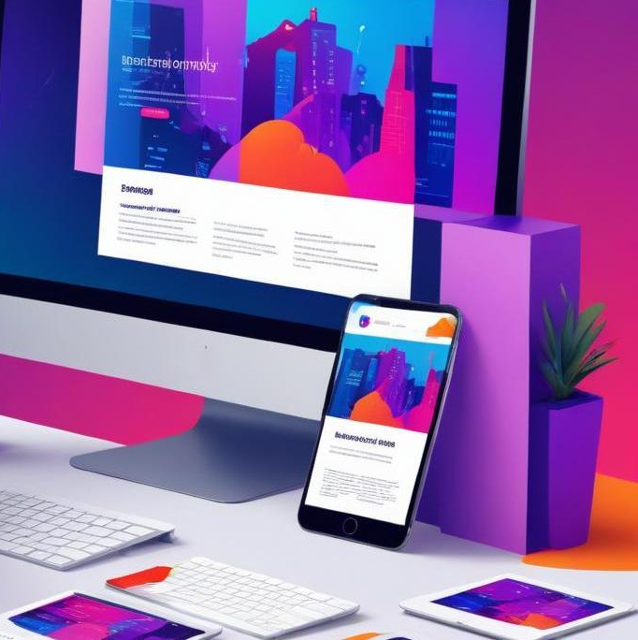
Responsive Design
Ensure your website is mobile-friendly and accessible on all devices. Implement flexible grids and layouts, use responsive images, and media queries to adapt to different screen sizes, improving user reach and experience.

Slide 13
User Experience
Focus on intuitive navigation, fast loading times, and engaging layouts to enhance user satisfaction. Conduct user testing and gather feedback to continually refine the website experience for visitors.

Slide 14
Content Management Systems
Choose the right CMS (e.g., WordPress, Joomla) that suits your needs. A good CMS allows easy updates, customizations, and user management to streamline content publishing and enhance website functionality.

Slide 15
04
Influencer Marketing

Slide 16
Identifying Influencers
Research and identify influencers within your niche who resonate with your brand values. Evaluate their audience demographics, engagement rates, and content relevance to ensure they align with your marketing goals.

Slide 17

Partnership Strategies
Develop mutually beneficial partnerships by aligning incentives with influencers. Create clear agreements detailing expectations, deliverables, and compensation to foster positive and productive collaborations.

Slide 18
Measuring Impact
Implement tracking mechanisms to assess the effectiveness of influencer campaigns. Evaluate metrics such as reach, engagement, conversions, and ROI to inform the success of your influencer marketing strategies.

Slide 19
05
Graphic & Logo Design

Slide 20
Brand Identity
Establish a strong brand identity through cohesive design elements that reflect your brand's values and mission. Consistency in colors, typography, and imagery builds recognition and trust among consumers.

Slide 21

Design Principles
Adhere to fundamental design principles such as balance, contrast, and alignment to create visually appealing graphics. Utilize negative space effectively and ensure that designs communicate the intended message clearly.

Slide 22
Tools and Software
Leverage design tools like Adobe Illustrator, Canva, or Sketch to create professional designs. Familiarize yourself with software that increases efficiency, such as project management tools to streamline design processes.

Slide 23
Conclusions
Grothony Global Solutions offers a comprehensive suite of digital services. By implementing effective strategies in digital marketing, website development, influencer marketing, and graphic design, businesses can enhance their online presence and drive growth.

